Slide 1
More APA Notes
You need to write these down AGAIN

Slide 2
Hints
Anything that is not common knowledge needs to have internal citation
The common form of internal citation is (name, year).
Anything in the reference page must be cited in the paper
The reference page is alphabetical by entry
You must alternate between your thoughts, direct quotations, summaries, and other thoughts from multiple sources ALTERNATE

Slide 3
This is what a reference page looks like
Last name, first initial. (year). Title.
Title of site or book.
Electronically retrieved
December 15, 2004 from
www.blahblahblah.com.

Slide 4

More notes
YOU MUST HAVE INTERNAL CITATIONS OF VARIOUS SOURCES INTERSPERSED WITH YOUR OWN THOUGHTS OR IT IS PLAGIARISM

Slide 5
A direct quote uses the exact words of the author:
According to Smith, “blah blah blah
blah blah blah” (2005, p. 12).
“blah blah blah bla” (Smith,
2005, para. 7).

Slide 6
More hints
Don’t push direct quotes or cited info together---put your own concepts in between cited info.
You must use internal citation because otherwise it is plagiarism.

Slide 7
Other concepts
Do not use 1st or second person
Do not say “my paper” or “this paper”
You must (at this point) use academic sources (not quote lists)
You must use appropriate internal citation (last name, year).
You must be “led” to the ref page by the appropriate internal citation

Slide 8
More APA stuff
YOU MUST USE INTERNAL CITATION EVEN IF YOU ARE NOT QUOTING INFO FROM ANOTHER SOURCE
THE POINT OF SOURCES IS TO SUPPORT YOUR IDEAS, NOT TO JUST SUMMARIZE OTHER STUFF.

Slide 9

Writing Basics

Slide 10
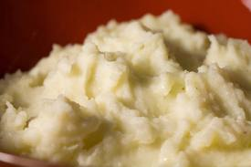
Being able to communicate well is a power no one can take away
However, not trying to increase your writing and speaking abilities means you are perfectly willing to give away your potential power and be mashed potatoes. I refuse for you to be mashed potatoes!

Slide 11
Thesis
The thesis holds everything together; in persuasive or argumentative papers, it is “a statement with which an intelligent person could argue” (Bellanca).
The thesis is the purpose of your paper, and every detail has to connect to the thesis through support.
Each topic sentence focuses a paragraph and also supports the thesis.

Slide 12

Thesis Metaphors
A thesis is your sword that allows you to make a point
A thesis is the bow that wraps it all together
A thesis is the shield that deflects opposing ideas
A good thesis is the difference between winning or losing (particularly in Patrick Henry’s case)

Slide 13
Sometimes, a thesis is a surprise-reversal
This is where you mention the opposite side in the thesis, but your paper and the rest of the thesis focuses on the primary argument: “Although most people believe meat should be included in every meal, one may discover health benefits by reducing the red meat eaten in a day.”
The paper would not be an opposition/refutation.
Instead, it would focus on the potential health benefits of reducing red meat.
No matter what, you do not want a “straw man argument.”

Slide 14
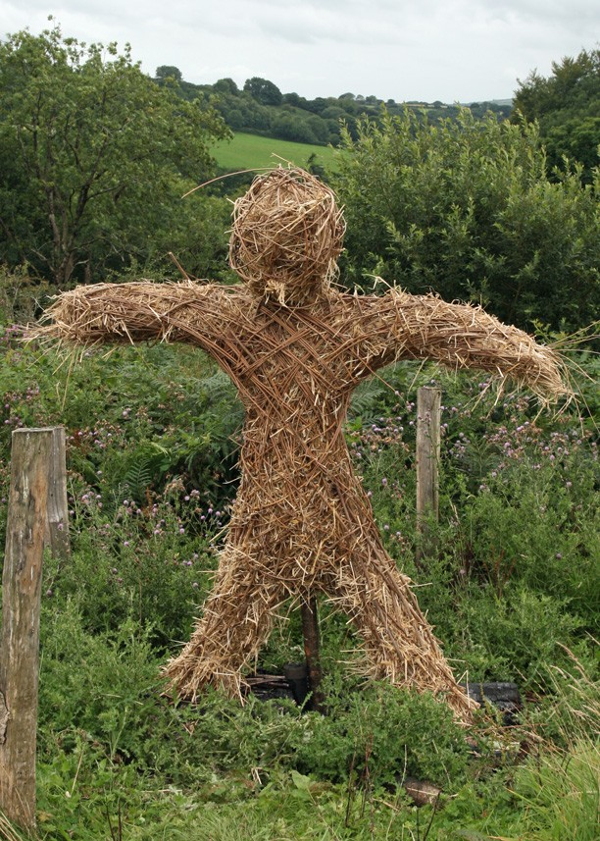
No “straw man” arguments
Straw man arguments are “duh” arguments that are easy to knock over, boring, and involve no thought
“Although many people skip breakfast, everyone should start the day with a good meal” is an example.

Slide 15
Point, proof, comment
Each topic sentence requires support to further support the thesis. Each bit of support might be considered a “point.”
After you make your point, you add “proof.” Proof might be an anecdote or a piece of research from a reputable source (not about.com or Wikipedia).
After the proof, you link it back to the topic sentence or thesis with a comment demonstrating relevance (this may also come in the form of a “for example” or a hypothetical situation connected to the point/proof.

Slide 16
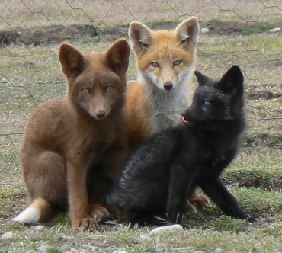
Fox Commercial

Slide 17
Important Aspects to Remember
Use vivid language (be descriptive)—pathos, logos, ethos (emotion, logic, ethics of the writer)
Use exact/specific words (no thing, really, very, stuff, contractions, second person)
Coordinating conjunctions (FANBOYS) have a comma, but two sentences together do not (that is a comma splice)
If a subordinate conjunction is at the start of a sentence, a comma occurs in the middle. No comma occurs if the word is in the middle.

