Slide 1
Barnet, Bellanca, and Stubbs
Presentation #2
(Chapters 7, 13, and 11)
Dr. Vicky Gilpin

Slide 2
Sources
Allow authors to hone their arguments
Primary sources are texts/movies/etc that are the chief subjects of someone’s writing; secondary sources are what others have to say about those works (articles, reviews, examinations)
You want to use as many primary sources as possible, but looking at criticism on your subject/topic/argument is important as well.
You need to be able to present others’ ideas (with correct citation), but you also need to be able to interact with those ideas and distinguish between those ideas and yours
SOURCES ARE USED TO GIVE YOU A MORE THOROUGH ARGUMENT

Slide 3

Wikipedia, about.com, Thought Catalog, or other items that show up in your Twitter feed or Facebook page are not good sources!!!!!

Slide 4
WHAT NOT TO DO
Skim a whole bunch of articles, blogs, videos, etc about your topic/concept without noting where particular thoughts came from, let those ideas meld together in your brain, and create some word-vomit paper (that might actually be quite good with interesting connections) where you do not remember who said what, so you cannot cite ideas correctly or weave them together to support your claims, so we spend the whole semester trying to undo the mishmash you have created by being unorganized about the whole “looking-stuff-up-thing.”

Slide 5
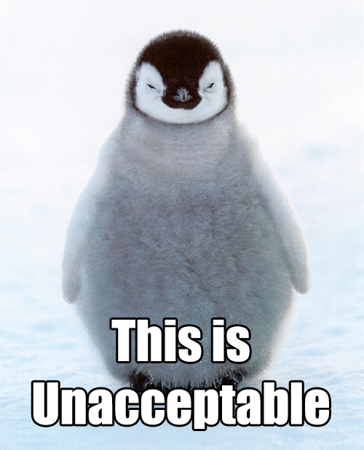

Slide 6
Getting/Finding/Using Good Sources
Generally, they have an author (some exceptions will be made if you have an emphasis in popular culture)
If you do not have an author, you will use the article or page title as what goes in the internal citation and to start the bibliographic entry.
Do not use scholar.google.com unless it gets you the entire article; too often, students think they can skim the abstract and just use that. Um, no, just no.
You may use some films, documentaries, videos, or other electronic sources; just talk to me about the correct documentation (Chapter 13).

Slide 7
SKILLS YOU NEED
(that’s why we’re doing this, by the way: to give you SKILLS or hone those you may already have, not just to torture you)

Slide 8
Summarization (109)
A summary is always shorter than the original writing (not sentence-for-sentence)
You must write the major ideas in your own words (items not in your own words are direct quotes and in quotation marks)
Present tense: Smith (2000) indicates blah blah blah (17).
The point of a summary is to give your readers the main point of something YOU HAVE READ. You are giving this information to support or lead to a major concept of your own.
You might only write a few sentences about an entire articles, but if they are well-written sentences, they will help you greatly.

Slide 9
Paraphrasing
A paraphrase may be around the same length of the original work
You do this to help your reader understand complex texts (ie, my powerpoints are a combination of direct quotations and paraphrase: my point is to help give you some information from this book, but I am not taking credit for the information given, and this isn’t a paper)
A paraphrase is in your own words
Just going to a work and restating the sentences in your own words or changing a few words around is PLAGIARISM
Most often, you will be using brief summaries and relying on direct quotations to support your ideas

Slide 10
Direct Quoting
This is using the exact words of a primary work to provide textual evidence of a point you are making or exact words of a secondary source to support your ideas or provide a viewpoint to refute
THIS IS NOT PADDING: I have had students wander through articles and randomly pick sentences to quote. That is silly and a waste of time.
You must always cite correctly by indicating who said the quotation, when they said it, and where they said it:
  Smith (2008) indicates, “blah blah blah” (18).
  However, “blah blah blah blah blah” (Jones, 1998, 22).
  Some critics disagree: “blah blah blah blah” (Powers, 2010, para. 33).

Slide 11
Block Quotations
If you are directly quoting four lines of text, you single-space it, indent all of the lines, and do not use quotation marks
You will still cite the author and important information

Slide 12
Other concerns with direct quotations
When you use direct quotations, you change NOTHING of the author’s work. Even if it goes against scholarly writing, your reader knows someone else said it.
If the authors used quotation marks, they become single quotation marks within your direct quotation.
If the author is already using a direct quotation, but you want to use it (like if it is an interview, so you cannot go to the primary source), you would start with the person who said it but cite it in your internal citation and reference page to where you got it:
Michael Jordon says, “to play the best, you’ve got to want the best” (cited in Smith, 2010, 16).
The period of the sentence “moves” to go after the internal citation:
  “Follow your bliss” (Campbell, 1970, 12).

Slide 13

Puppy Break

Slide 14
You must acknowledge an author
When you find research to support your ideas
When using exact words from the author
When using the concepts from the author in your own words
--------------------------------------------------------------------------------------------------
Yes, I realize you may have an idea someone has had before. That’s fine, great in fact. However, with the emphasis on research, you need to be looking for examples of those ideas. It does not mean you have to revise your whole paper: it means you get to use that idea as support.
You use other sources to weave through your paper with POINT, PROOF, COMMENT method to build a strong case.

Slide 15
Learn from my mistakes:
Keep a notebook (or notepad on phone) or something that will allow you to keep information (author, biblio stuff, major ideas/summaries of articles). TRUST ME: you want to be able to find your information
Save or print the articles you may use. You do not want to be trying to hunt them down later.
Email ALL rough versions of everything to yourself, get a USB, and take pictures of information if you must: you cannot “lose” your work in this class
Save all old versions of drafts to edit later or because something you could not use in one section may help later

Slide 16
MAJOR TOOLS FOR THIS PROJECT
Highlighter (we will spend more time on this)
Mini Post-Its for marking pages
A notebook/folder (either electronic or physical) to keep articles, thoughts, everything together
A binder to ultimately put all of your work in for assessment
A USB drive/thumb drive/jump drive TRUST ME
A working email account: you want to be able to use email as a way to save your work as well as have it somewhere you can get to it (Google docs works this way, but it does not always have the best editing tools)

Slide 17
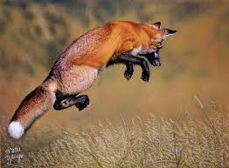
One Final Skill

Slide 18
You must have good writing skills or good editing skills
(more on this later)
A fragment is part of a sentence set up like a sentence
A comma splice is when a comma is accidentally placed between two complete sentences/clauses. It may be fixed in a variety of ways
  Use a period to create two sentences
  Use a semicolon
  Use a comma and a coordinating conjunction (FANBOY)
  Use a subordinating conjunction and possibly a comma
  Reword it to reduce one of the clauses entirely
                (246-247)

Slide 19
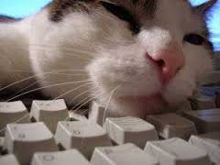
Thank you!

